Slide 1

Introduction to Probabilistic Machine Learning
Ralf Herbrich
Graphical Models: Inference

Slide 2
Overview
Factor Graphs
Marginalization by Importance Sampling
Marginalization by the Sum-Product Algorithm
Practical Considerations in Message Passing

Slide 3
Overview
Factor Graphs
Marginalization by Importance Sampling
Marginalization by the Sum-Product Algorithm
Practical Considerations in Message Passing

Slide 4




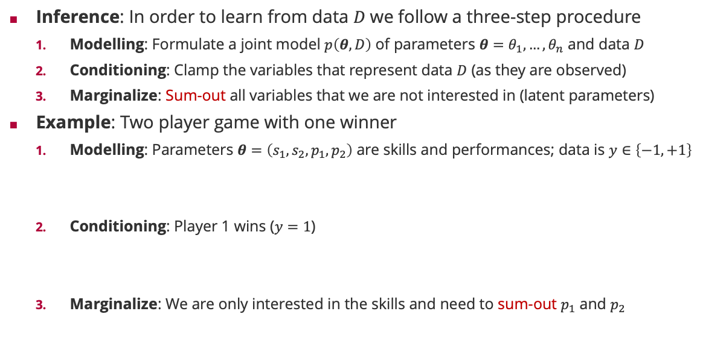



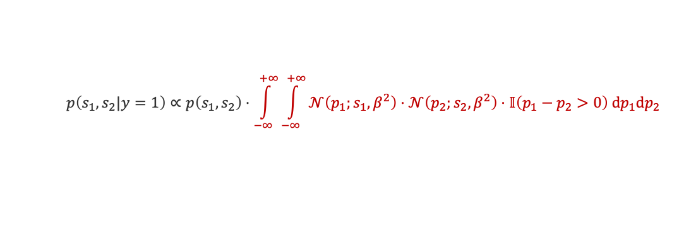

Inference in Probabilistic Models
Inference: In order to learn from data $D$we follow a three-step procedure
Modelling: Formulate a joint model $p\left(θ,D\right)$ of parameters $θ=θ_{1},…,θ_{n}$ and data $D$
Conditioning: Clamp the variables that represent data $D$ (as they are observed)
Marginalize: Sum-out all variables that we are not interested in (latent parameters)
Example: Two player game with one winner
Modelling: Parameters $θ=\left(s_{1},s_{2},p_{1},p_{2}\right)$ are skills and performances; data is $y∈\left\{−1,+1\right\}$
Conditioning: Player 1 wins ($y=1$)
Marginalize: We are only interested in the skills and need to sum-out $p_{1}$ and $p_{2}$
$$S_{1}$$
$$S_{2}$$
$$P_{1}$$
$$P_{2}$$
$$Y$$
$$p\left(s_{1},s_{2},p_{1},p_{2},y\right)=$$
$$𝒩\left(s_{1};μ_{1},σ_{1}^{2}\right)⋅𝒩\left(s_{2};μ_{2},σ_{2}^{2}\right)$$
$$⋅𝒩\left(p_{1};s_{1},β^{2}\right)⋅𝒩\left(p_{2};s_{2},β^{2}\right)$$
$$⋅𝕀\left(y\left(p_{1}−p_{2}\right)>0\right)$$
$$p\left(s_{1},s_{2},p_{1},p_{2}|y=1\right)∝𝒩\left(s_{1};μ_{1},σ_{1}^{2}\right)⋅𝒩\left(s_{2};μ_{2},σ_{2}^{2}\right)⋅𝒩\left(p_{1};s_{1},β^{2}\right)⋅𝒩\left(p_{2};s_{2},β^{2}\right)⋅𝕀\left(p_{1}−p_{2}>0\right)$$
$$p\left(s_{1},s_{2}|y=1\right)∝p\left(s_{1},s_{2}\right)⋅\int_{−∞}^{+∞}{\int_{−∞}^{+∞}{𝒩\left(p_{1};s_{1},β^{2}\right)⋅𝒩\left(p_{2};s_{2},β^{2}\right)⋅𝕀\left(p_{1}−p_{2}>0\right) dp_{1}dp_{2}}}$$

Slide 5

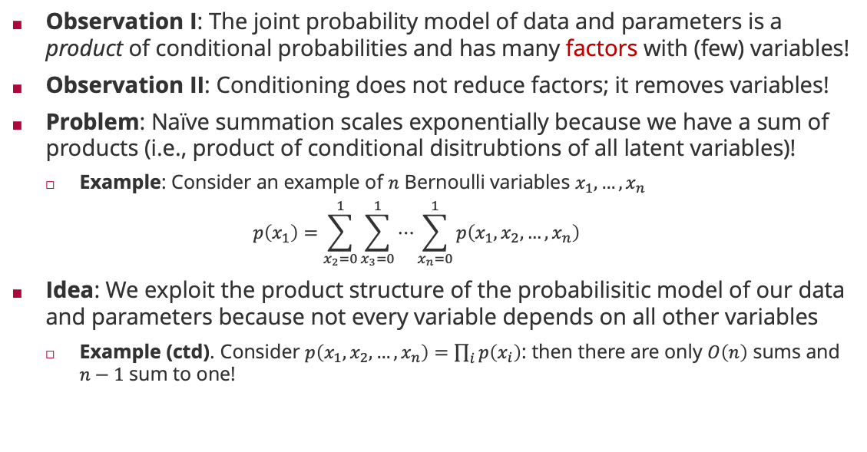
Factors, Variables and Probabilistic Inference
Observation I: The joint probability model of data and parameters is a product of conditional probabilities and has many factors with (few) variables!
Observation II: Conditioning does not reduce factors; it removes variables!
Problem: Naïve summation scales exponentially because we have a sum of products (i.e., product of conditional disitrubtions of all latent variables)!
Example: Consider an example of $n$ Bernoulli variables $x_{1},…,x_{n}$
$$p\left(x_{1}\right)=\sum_{x_{2}=0}^{1}{\sum_{x_{3}=0}^{1}{⋯\sum_{x_{n}=0}^{1}{p\left(x_{1},x_{2},…,x_{n}\right)}}}$$
Idea: We exploit the product structure of the probabilisitic model of our data and parameters because not every variable depends on all other variables
Example (ctd). Consider $p\left(x_{1},x_{2},…,x_{n}\right)=\prod_{i}{p\left(x_{i}\right)}$: then there are only $O\left(n\right)$ sums and $n−1$ sum to one!
$2^{n−1}$ summations

Slide 6





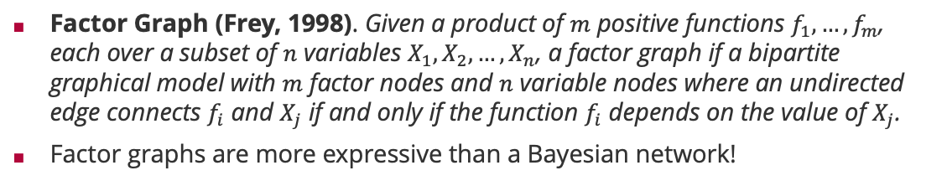








Factor Graphs
Factor Graph (Frey, 1998). Given a product of $m$ positive functions $f_{1}, …,f_{m}$, each over a subset of $n$ variables $X_{1},X_{2},…,X_{n}$, a factor graph if a bipartite graphical model with $m$ factor nodes and $n$ variable nodes where an undirected edge connects $f_{i}$ and $X_{j}$ if and only if the function $f_{i}$ depends on the value of $X_{j}$.
Factor graphs are more expressive than a Bayesian network!
Brendan Frey (1968 – )
Bayesian network
Corresponding factor graph
Factor graph with more structure
$$X_{1}$$
$$X_{2}$$
$$X_{1}$$
$$X_{2}$$
$$X_{1}$$
$$X_{2}$$
$$X_{3}$$
$$X_{3}$$
$$X_{3}$$
$$p\left(x_{1},x_{2},x_{3}\right)=p\left(x_{1}\right)⋅p\left(x_{2}\right)⋅p\left(x_{3}|x_{1},x_{2}\right)$$
$$p\left(x_{1},x_{2},x_{3}\right)=f_{1}\left(x_{1}\right)⋅f_{2}\left(x_{2}\right)⋅f_{3}\left(x_{3},x_{1},x_{2}\right)$$
$$p\left(x_{1},x_{2},x_{3}\right)=f_{1}\left(x_{1}\right)⋅f_{2}\left(x_{2}\right)⋅f_{3}\left(x_{1},x_{3}\right)⋅f_{4}\left(x_{2},x_{3}\right)$$
Structure in $p\left(x_{3}|x_{1},x_{2}\right)$

Slide 7
Overview
Factor Graphs
Marginalization by Importance Sampling
Marginalization by the Sum-Product Algorithm
Practical Considerations in Message Passing

Slide 8
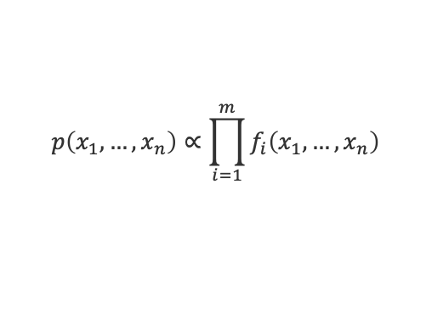
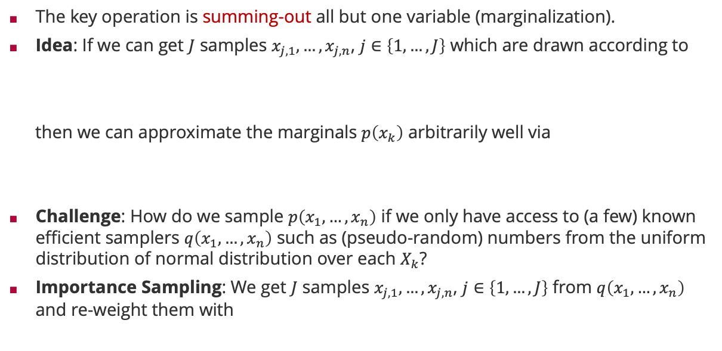
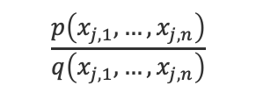
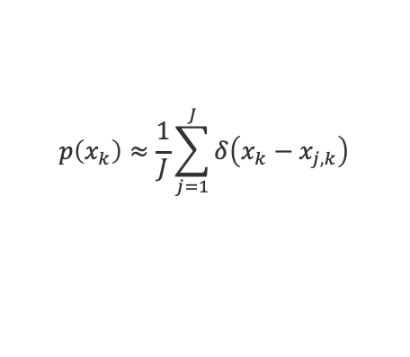
Inference by Importance Sampling
The key operation is summing-out all but one variable (marginalization).
Idea: If we can get $J$ samples $x_{j,1},…,x_{j,n}$, $j∈\left\{1,…,J\right\}$ which are drawn according to
then we can approximate the marginals $p\left(x_{k}\right)$ arbitrarily well via
Challenge: How do we sample $p\left(x_{1},…,x_{n}\right)$ if we only have access to (a few) known efficient samplers $q\left(x_{1},…,x_{n}\right)$ such as (pseudo-random) numbers from the uniform distribution of normal distribution over each $X_{k}$?
Importance Sampling: We get $J$ samples $x_{j,1},…,x_{j,n}$, $j∈\left\{1,…,J\right\}$ from $q\left(x_{1},…,x_{n}\right)$ and re-weight them with
$$p\left(x_{1},…,x_{n}\right)∝\prod_{i=1}^{m}{f_{i}\left(x_{1},…,x_{n}\right)}$$
$$p\left(x_{k}\right)≈\frac{1}{J}\sum_{j=1}^{J}{δ\left(x_{k}−x_{j,k}\right)}$$
$$\frac{p\left(x_{j,1},…,x_{j,n}\right)}{q\left(x_{j,1},…,x_{j,n}\right)}$$
Importance weight

Slide 9
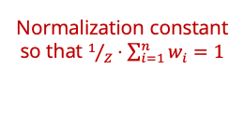
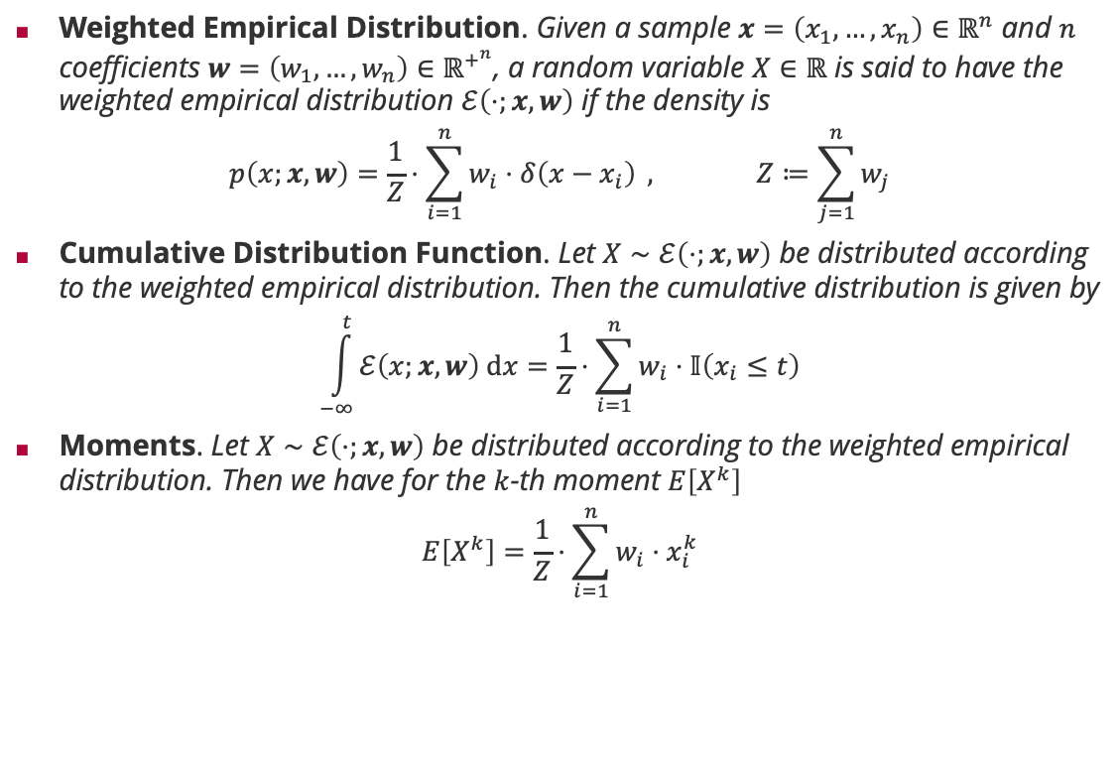
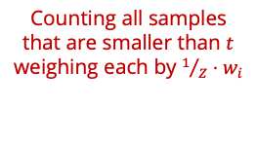
Weighted-Empirical Distribution
Weighted Empirical Distribution. Given a sample $x=\left(x_{1},…,x_{n}\right)∈ℝ^{n}$ and $n$ coefficients $w=\left(w_{1},…,w_{n}\right)∈ℝ^{+^{n}}$, a random variable $X∈ℝ$ is said to have the weighted empirical distribution $ℰ\left(⋅;x,w\right)$ if the density is
$$p\left(x;x,w\right)=\frac{1}{Z}⋅\sum_{i=1}^{n}{w_{i}⋅δ\left(x−x_{i}\right)} , Z≔\sum_{j=1}^{n}{w_{j}}$$
Cumulative Distribution Function. Let $X∼ℰ\left(⋅;x,w\right)$ be distributed according to the weighted empirical distribution. Then the cumulative distribution is given by
$$\int_{−∞}^{t}{ℰ\left(x;x,w\right) dx}=\frac{1}{Z}⋅\sum_{i=1}^{n}{w_{i}⋅𝕀\left(x_{i}≤t\right)}$$
Moments. Let $X∼ℰ\left(⋅;x,w\right)$ be distributed according to the weighted empirical distribution. Then we have for the $k$-th moment $E\left[X^{k}\right]$
$$E\left[X^{k}\right]=\frac{1}{Z}⋅\sum_{i=1}^{n}{w_{i}⋅x_{i}^{k}}$$
Normalization constant so that $1/Z⋅\sum_{i=1}^{n}{w_{i}}=1$
Counting all samples that are smaller than $t$ weighing each by ${1/Z⋅w}_{i}$
Weighted sample averages

Slide 10
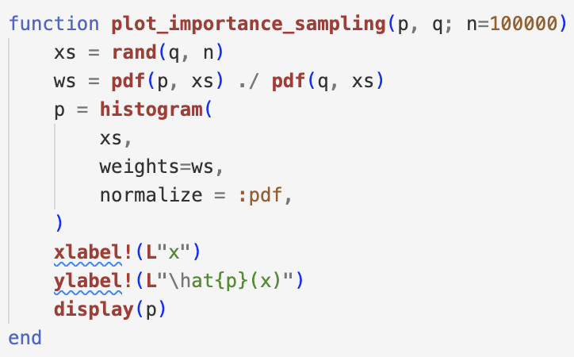




Importance Sampling in Pictures
Too little weight in the proposal
$$p\left(x\right)=𝒩\left(x;0,1\right)$$
$$q\left(x\right)=𝒩\left(x;0,1\right)$$
$$q\left(x\right)=𝒩\left(x;1.5,1\right)$$
$$q\left(x\right)=𝒰\left(x;−2.5,2.5\right)$$
Zero weight in the proposal

Slide 11
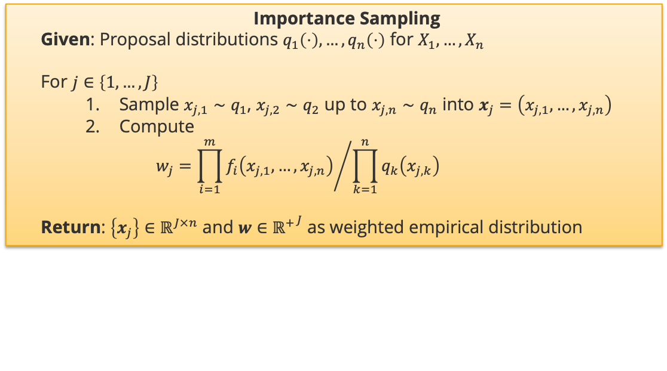
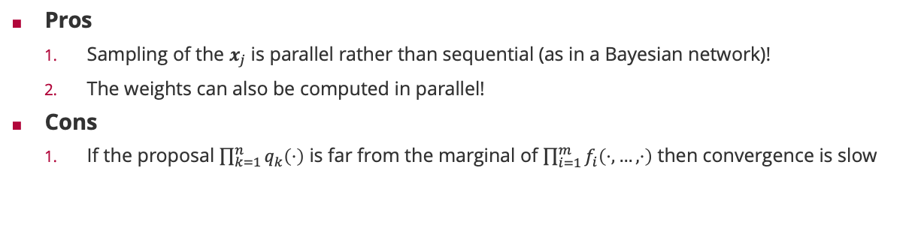
Marginalization by Sampling a Factor Graph
Importance Sampling
Given: Proposal distributions $q_{1}\left(⋅\right),…,q_{n}\left(⋅\right)$ for $X_{1},…,X_{n}$
For $j∈\left\{1,…,J\right\}$
Sample $x_{j,1}∼q_{1}$, $x_{j,2}∼q_{2}$ up to $x_{j,n}∼q_{n}$ into $x_{j}=\left(x_{j,1},…,x_{j,n}\right)$
Compute
$$w_{j}={\prod_{i=1}^{m}{f_{i}\left(x_{j,1},…,x_{j,n}\right)}}/{\prod_{k=1}^{n}{q_{k}\left(x_{j,k}\right)}}$$
Return: $\left\{x_{j}\right\}∈ℝ^{J×n}$ and $w∈{ℝ^{+}}^{J}$ as weighted empirical distribution
Pros
Sampling of the $x_{j}$ is parallel rather than sequential (as in a Bayesian network)!
The weights can also be computed in parallel!
Cons
If the proposal $\prod_{k=1}^{n}{q_{k}\left(⋅\right)}$ is far from the marginal of $\prod_{i=1}^{m}{f_{i}\left(⋅,…,⋅\right)}$ then convergence is slow

Slide 12
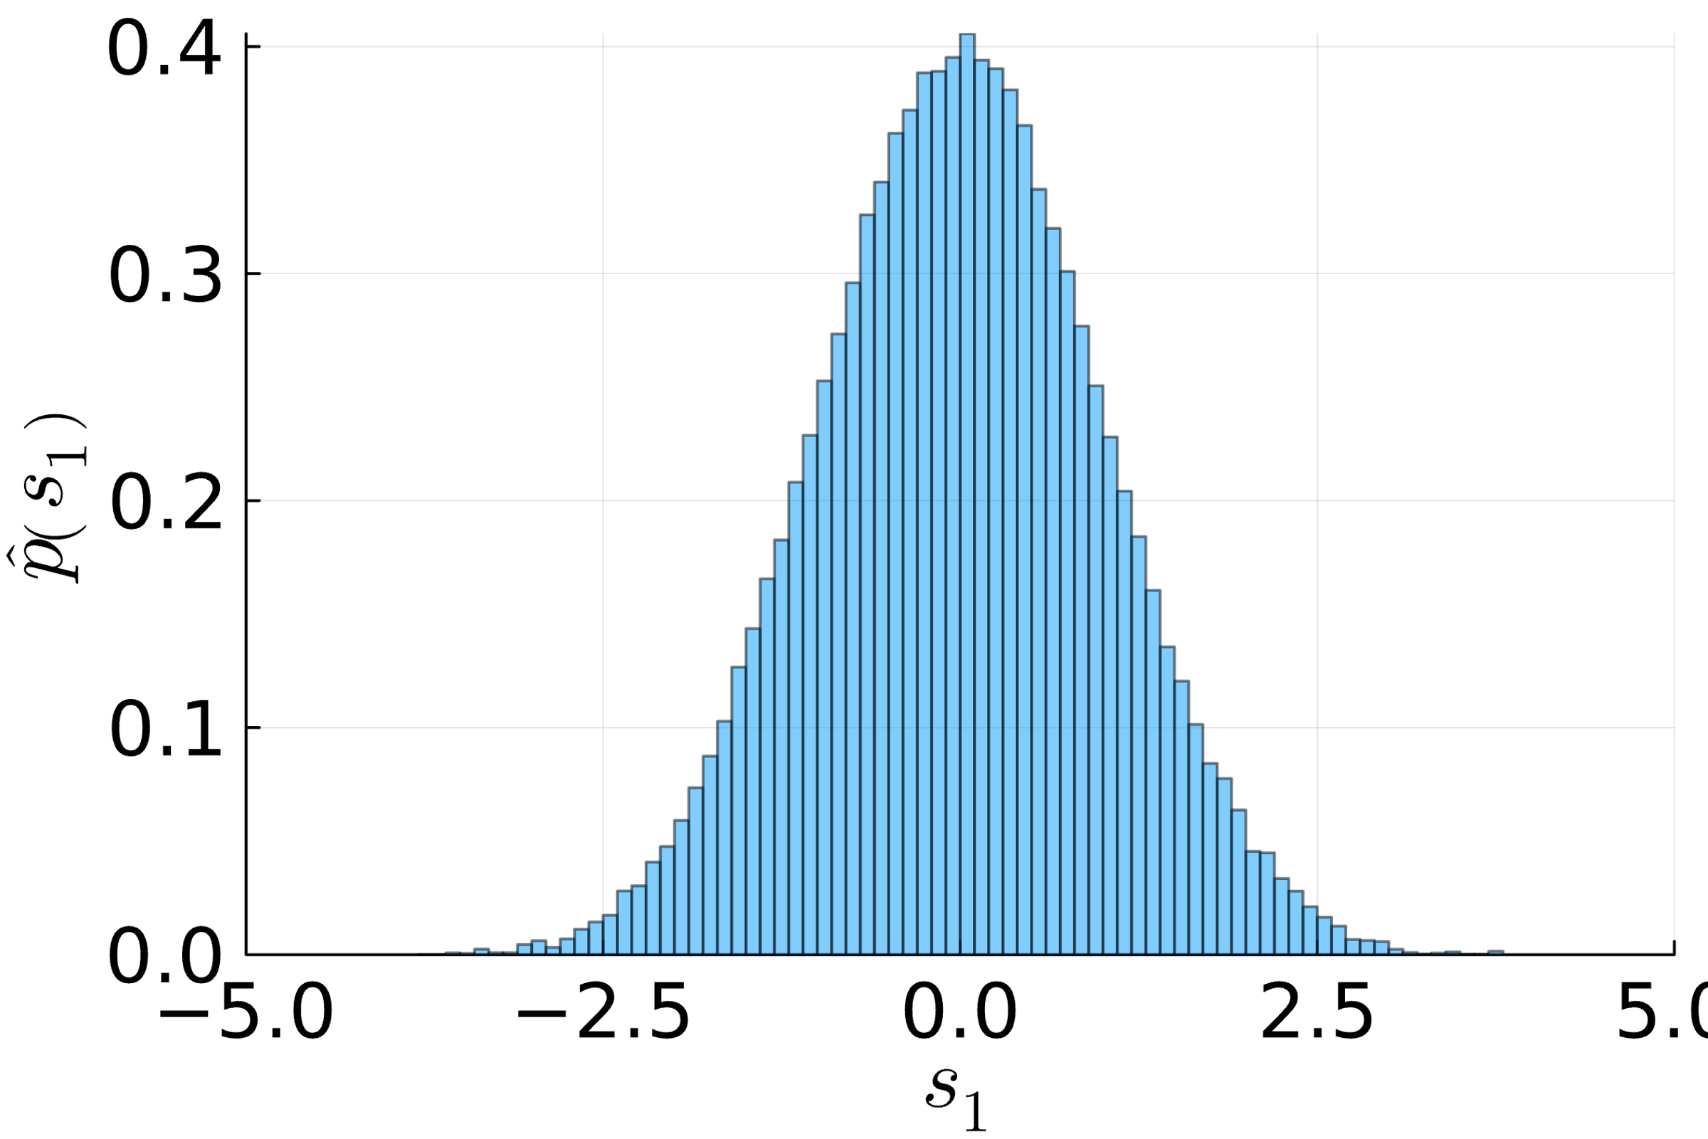

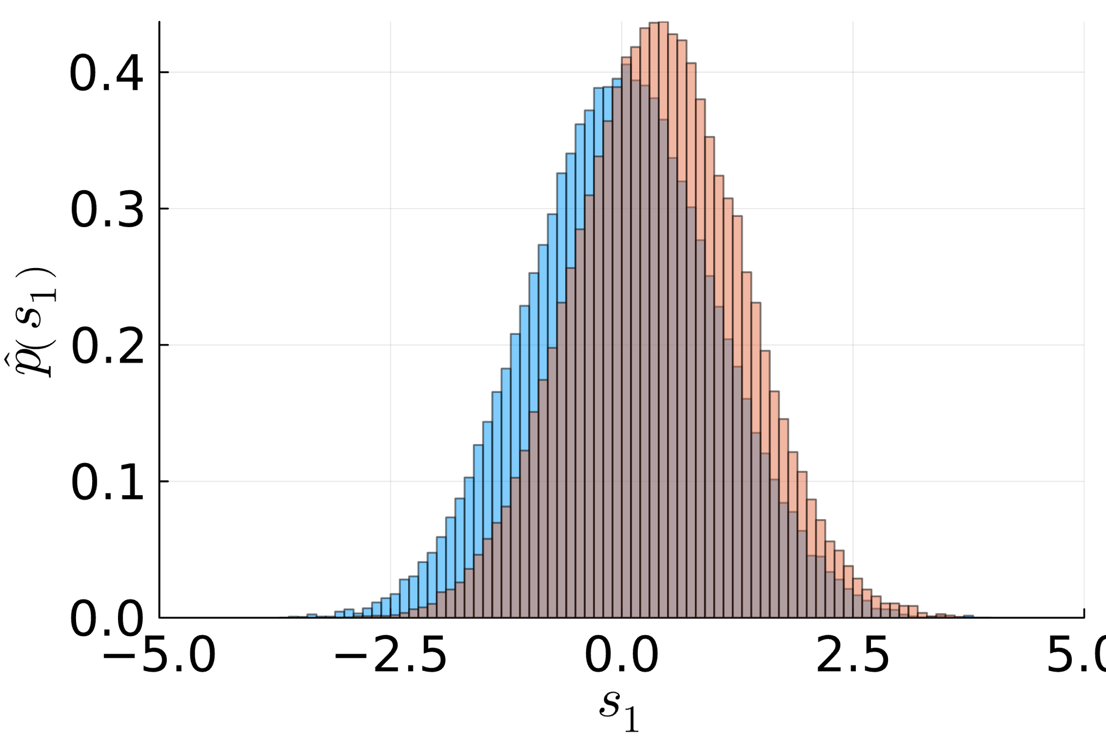
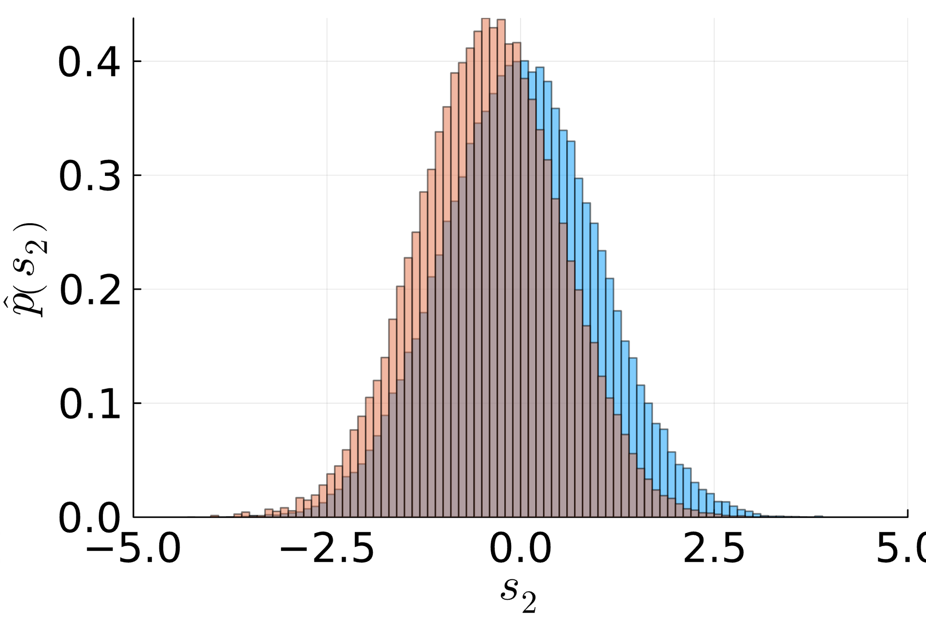
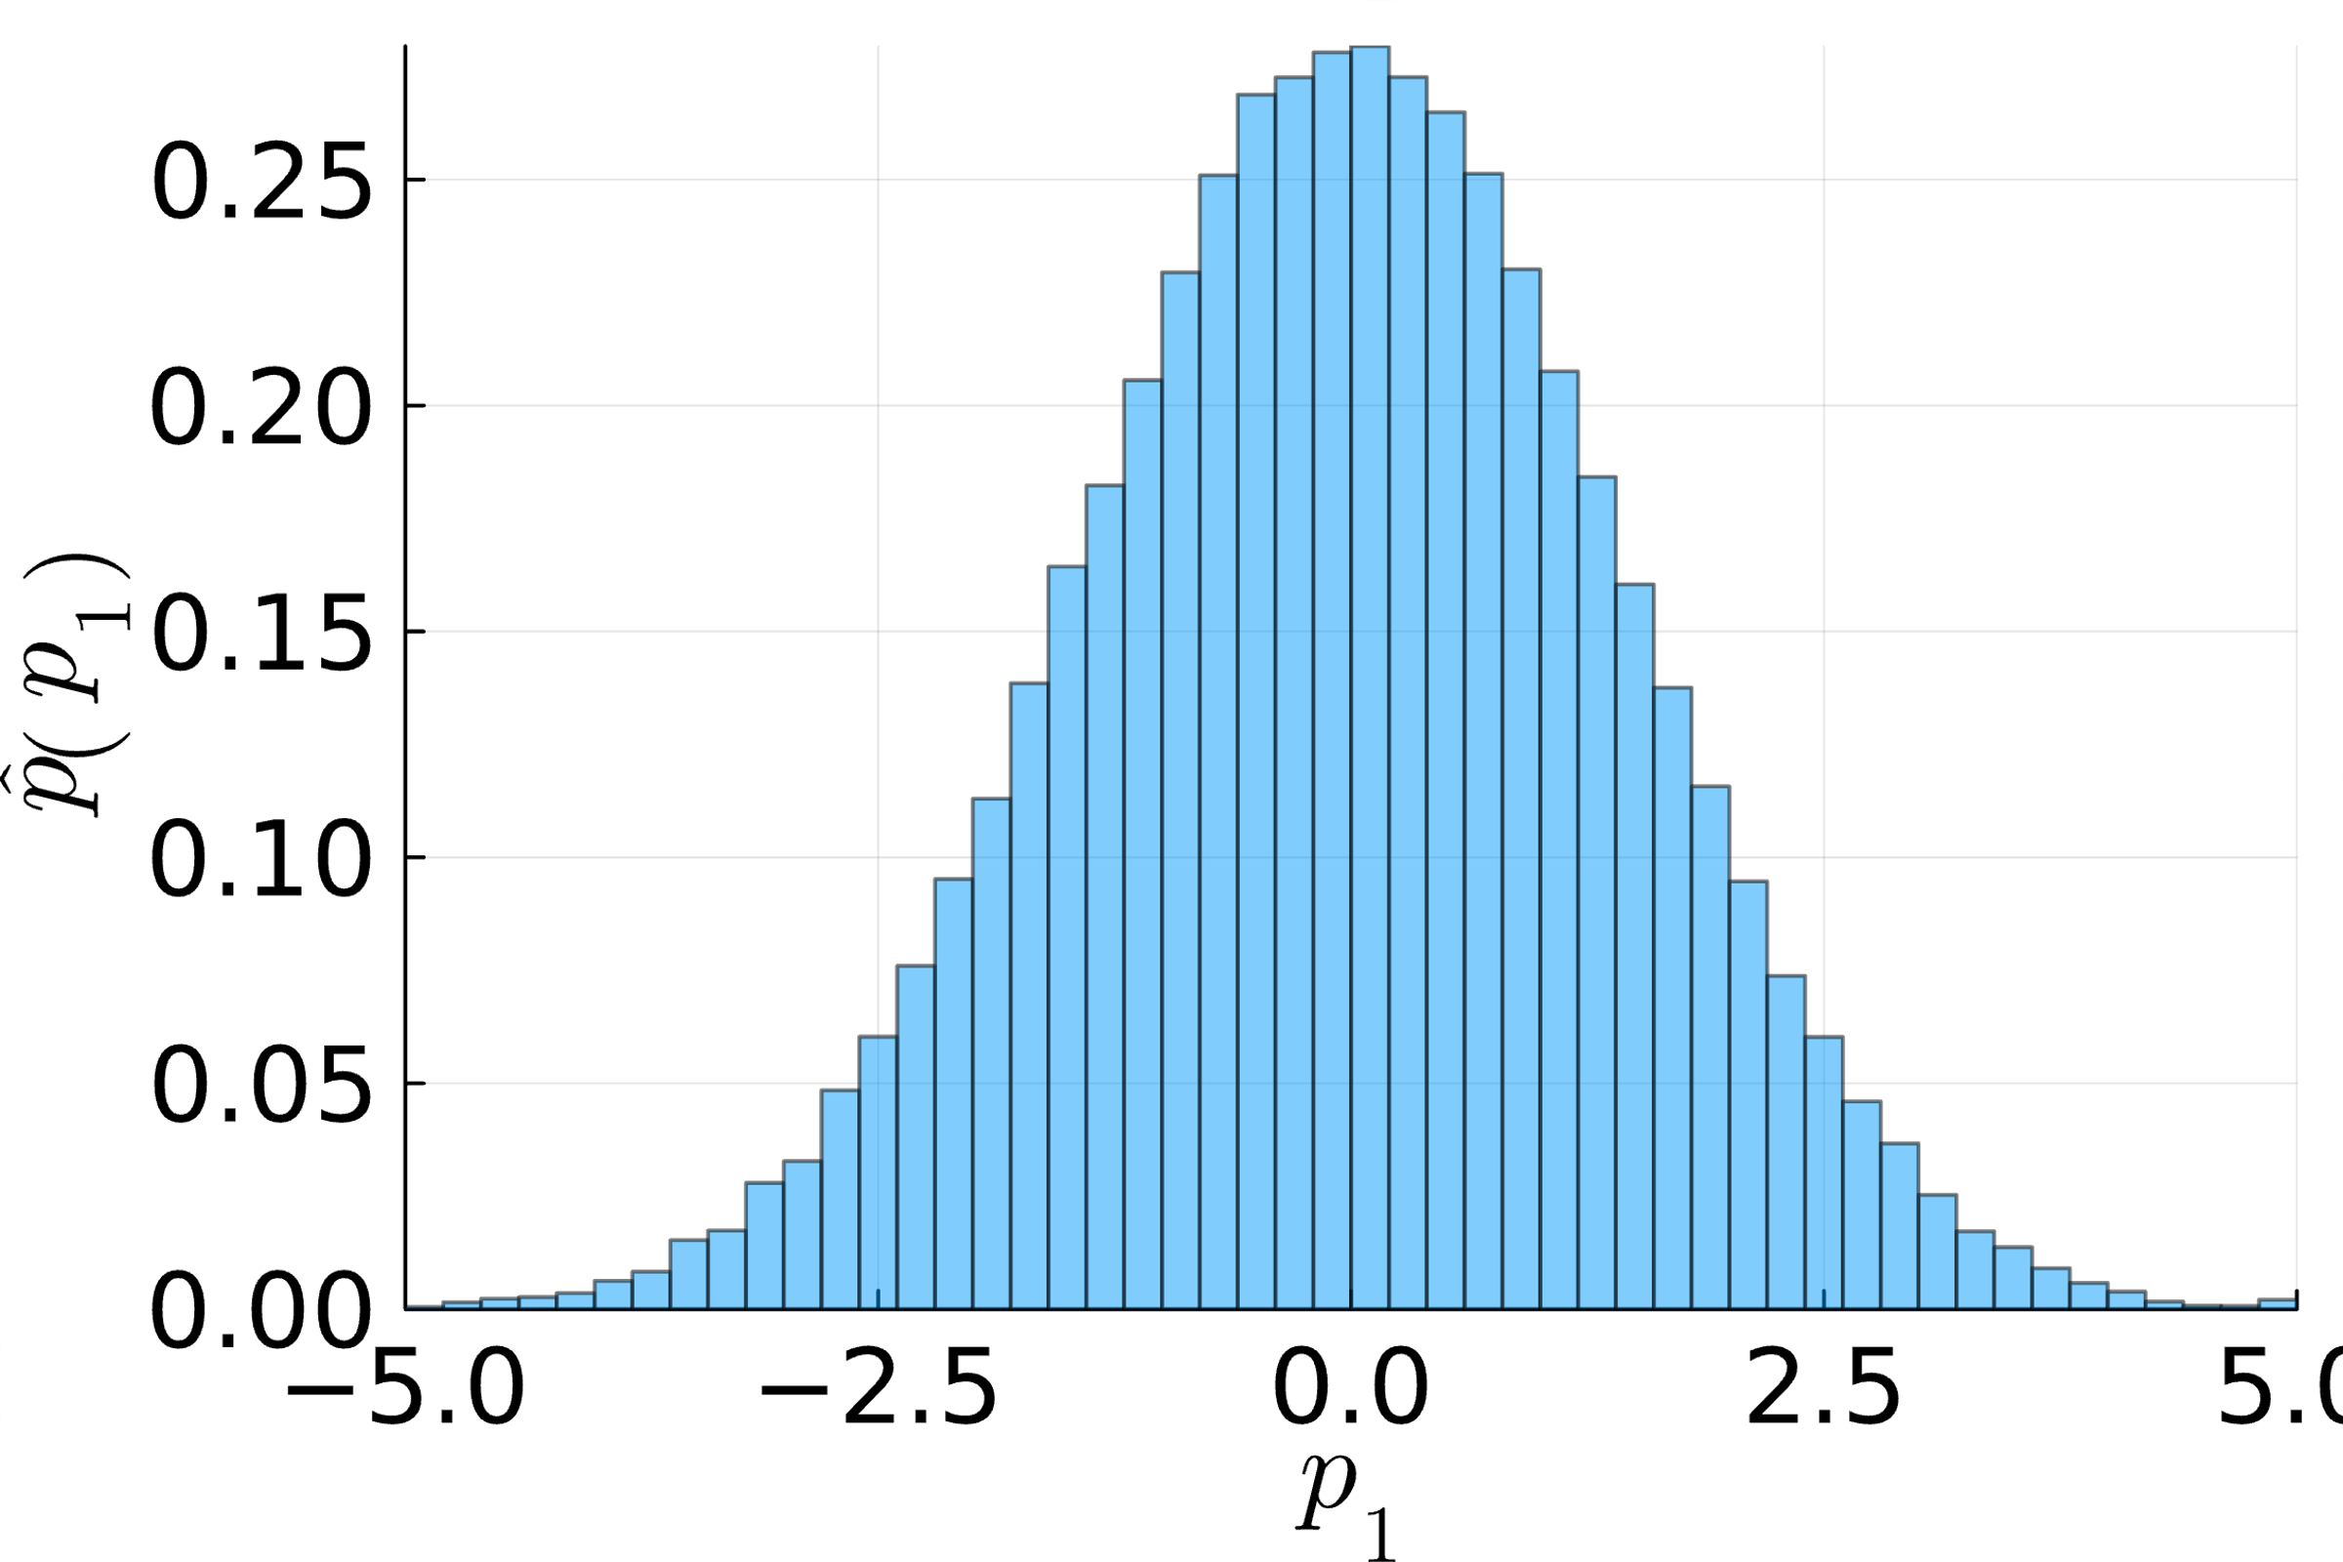

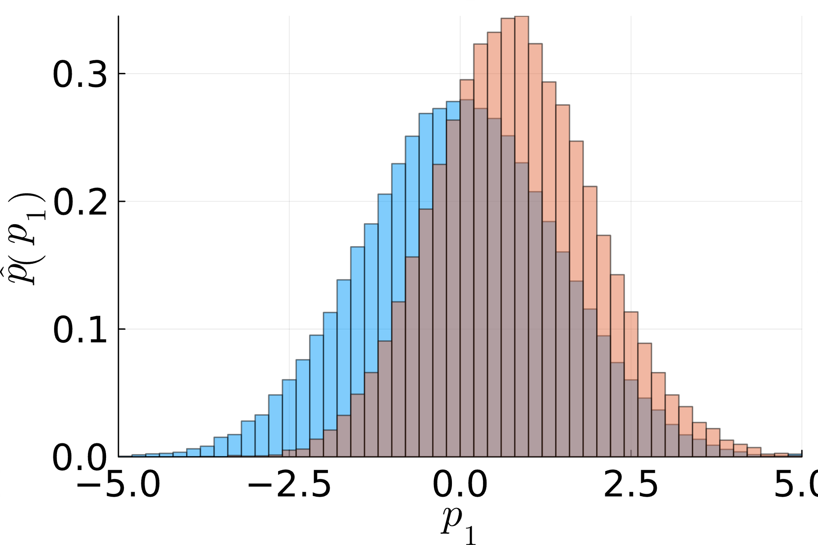
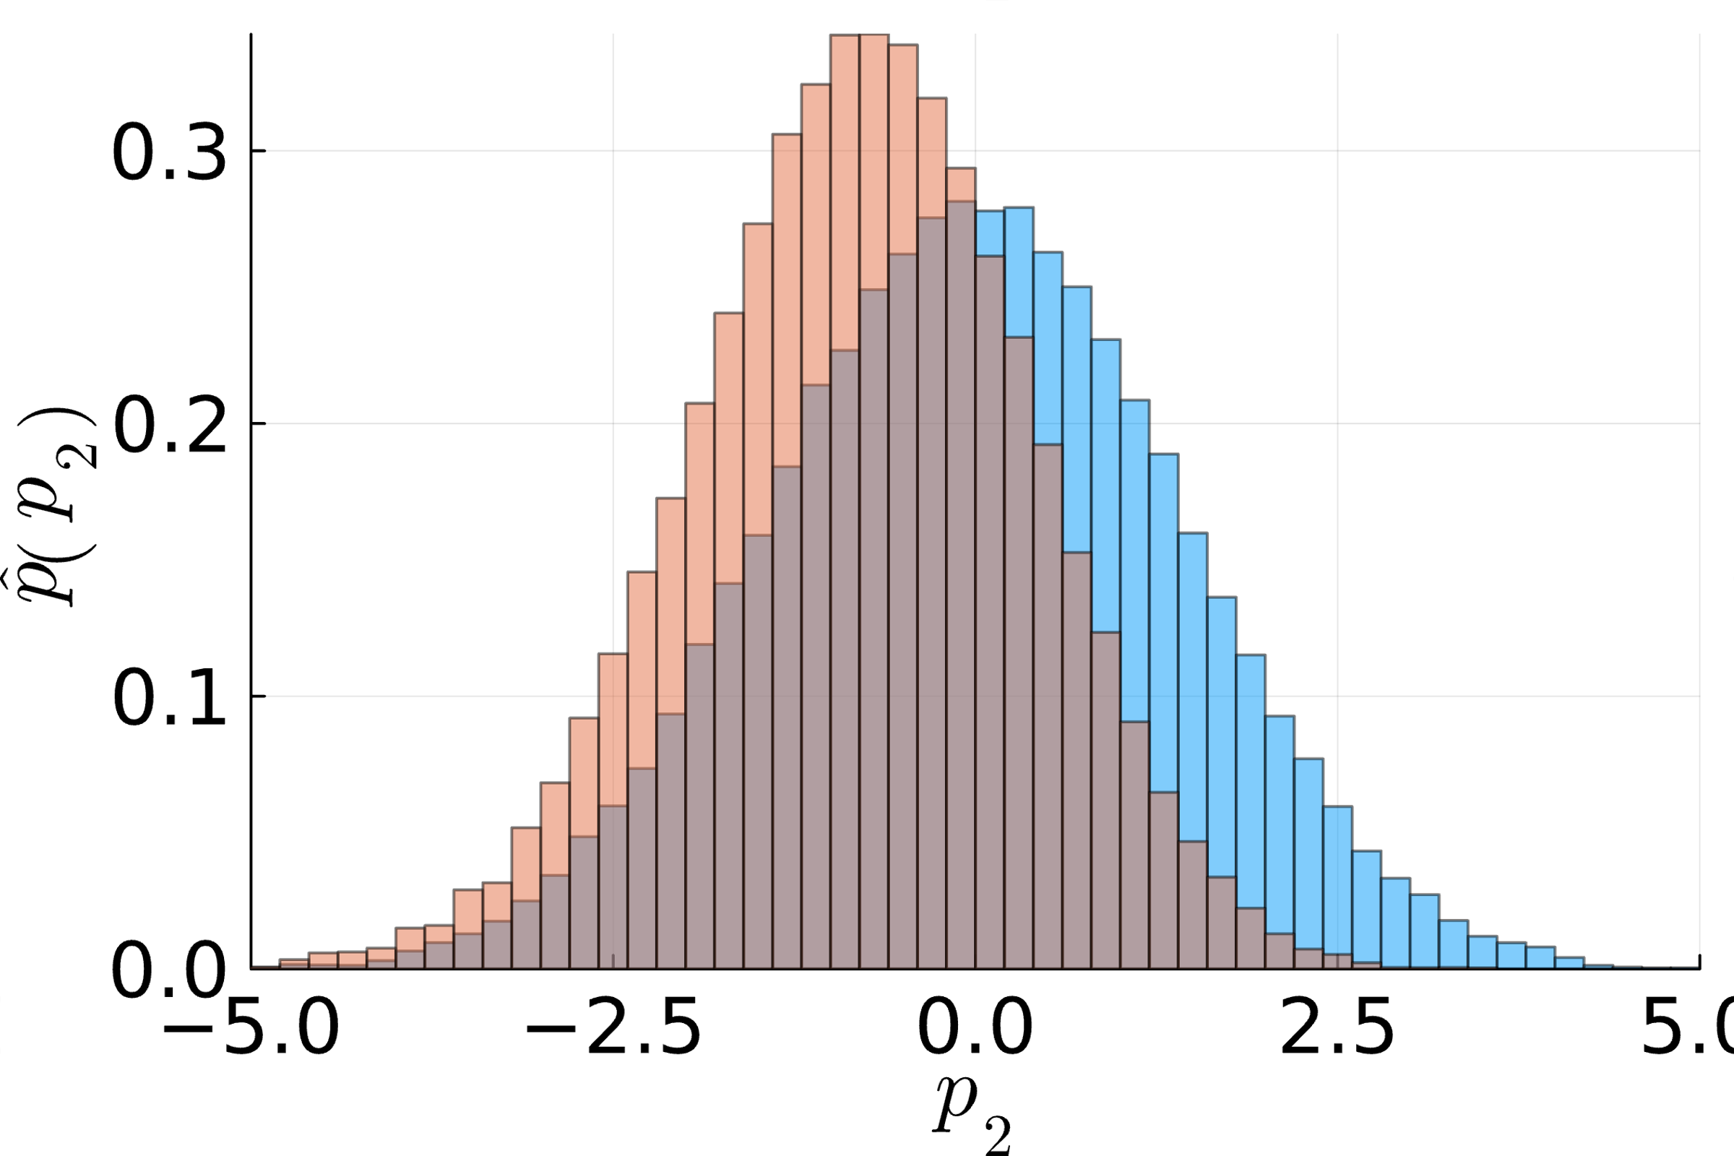
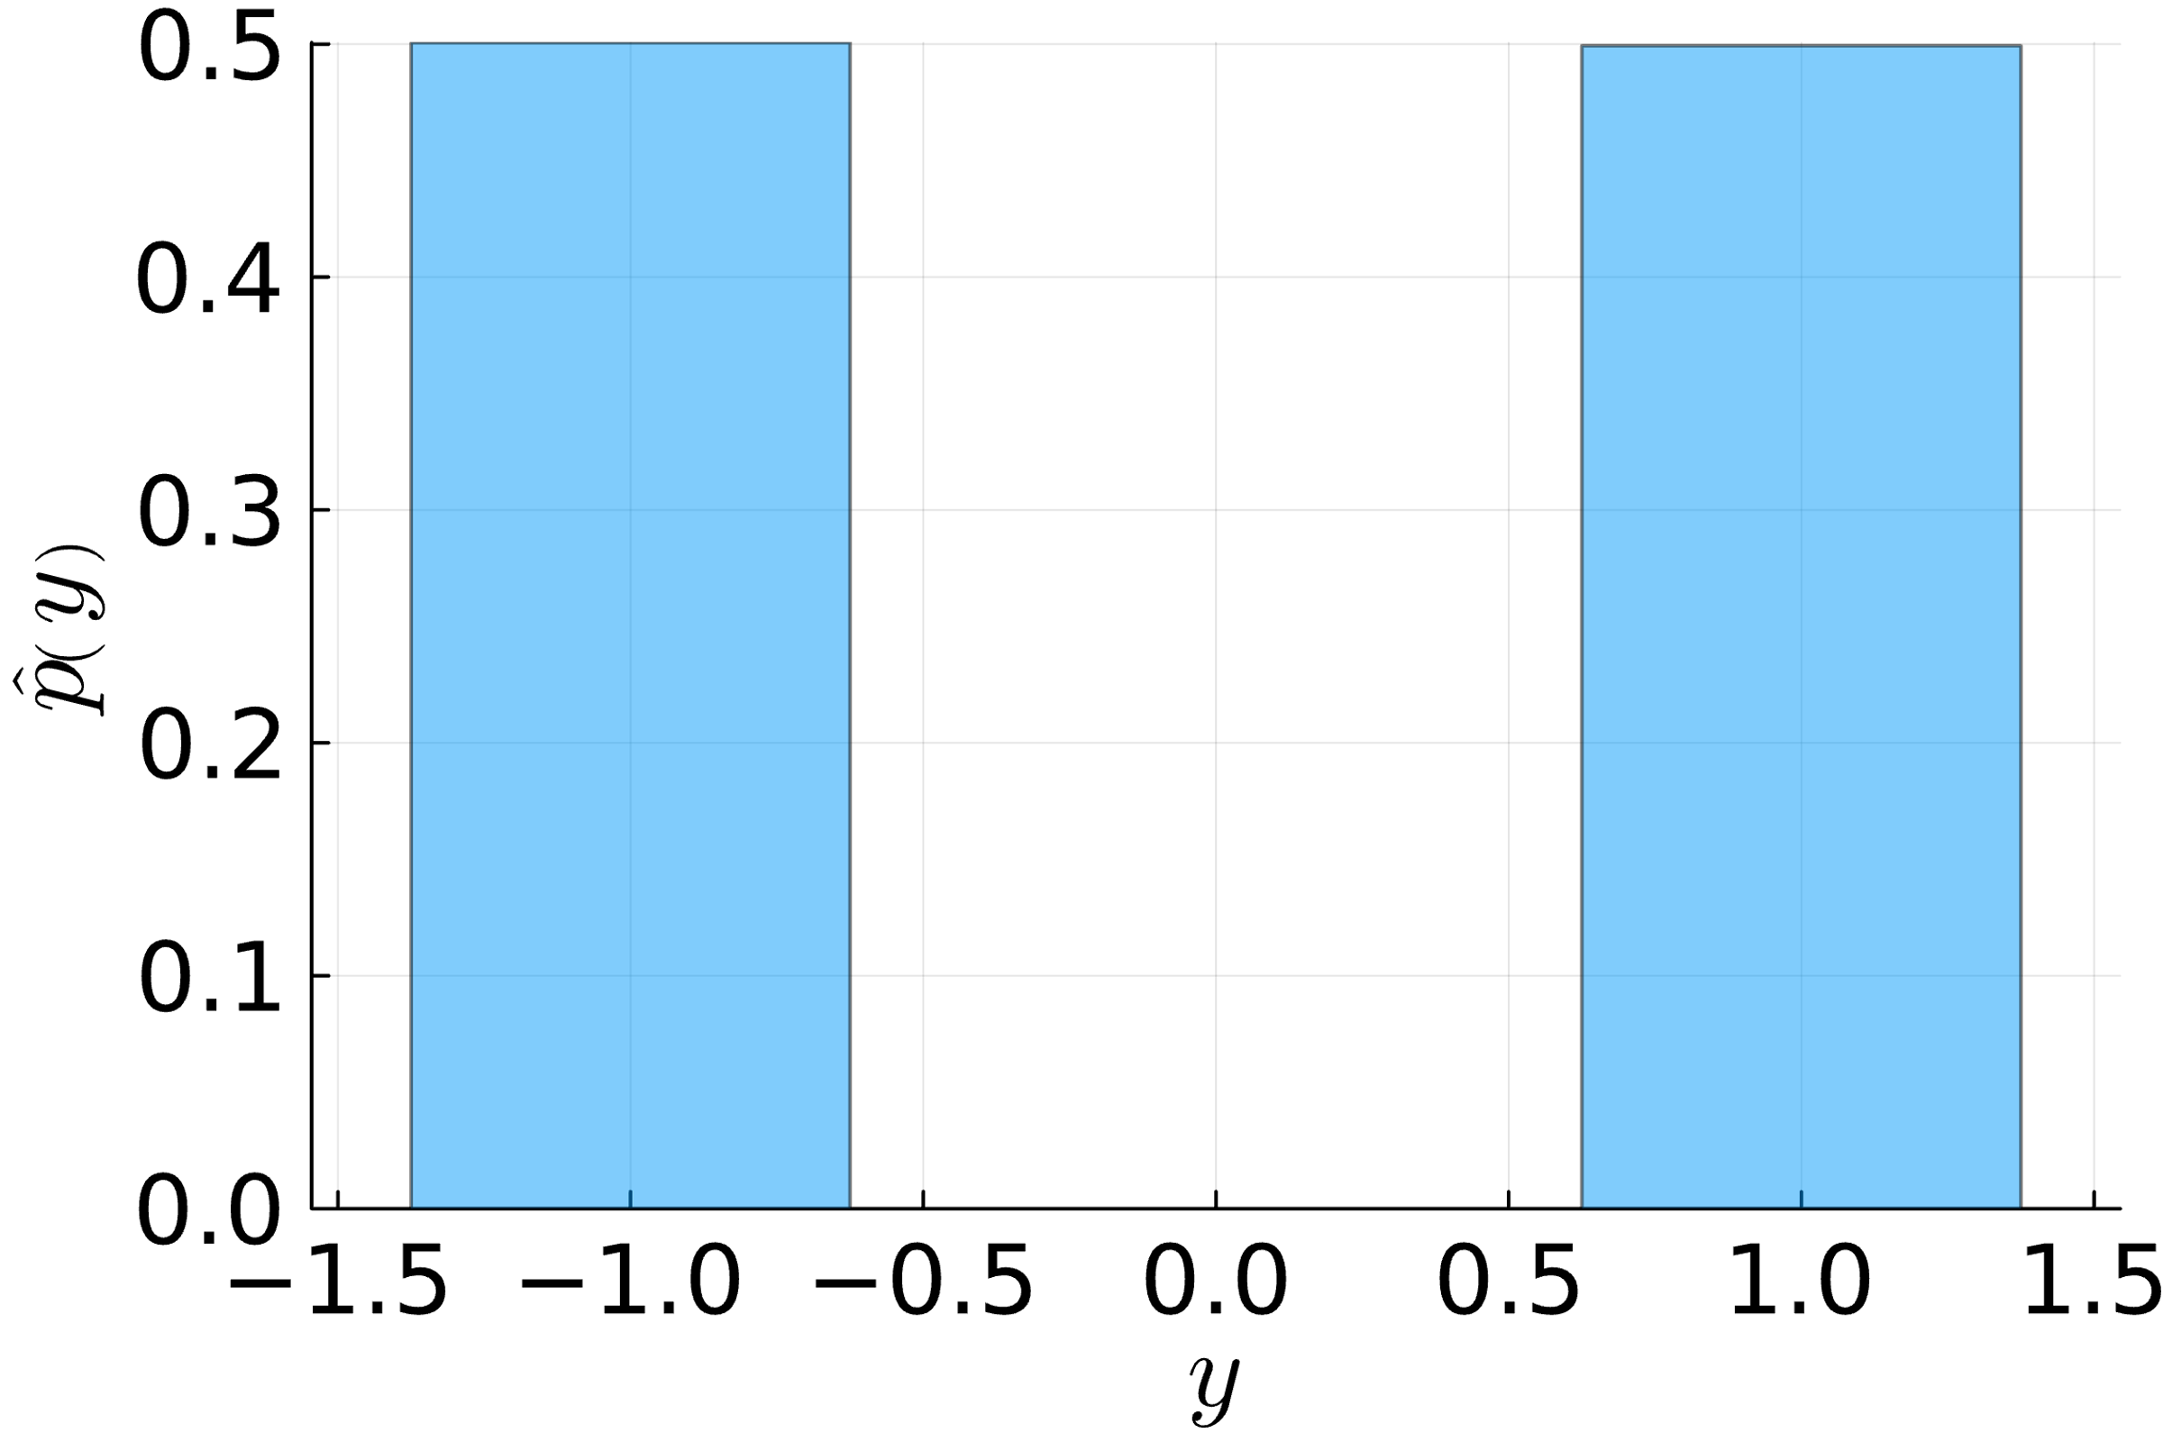














Marginalization by Sampling a Factor Graph: Example
$$𝒩\left(s_{1};μ_{1},σ_{1}^{2}\right)⋅𝒩\left(s_{2};μ_{2},σ_{2}^{2}\right)⋅𝒩\left(p_{1};s_{1},β^{2}\right)⋅𝒩\left(p_{2};s_{2},β^{2}\right)⋅𝕀\left(y\left(p_{1}−p_{2}\right)>0\right)$$
$$S_{1}$$
$$S_{2}$$
$$P_{1}$$
$$P_{2}$$
Without match outcome
With match outcome ($y=1$)
$$Y$$
$$S_{1}$$
$$S_{2}$$
$$S_{1}$$
$$S_{2}$$
$$P_{1}$$
$$P_{2}$$
$$P_{1}$$
$$P_{2}$$
$$Y$$

Slide 13
Overview
Factor Graphs
Marginalization by Importance Sampling
Marginalization by the Sum-Product Algorithm
Practical Considerations in Message Passing

Slide 14
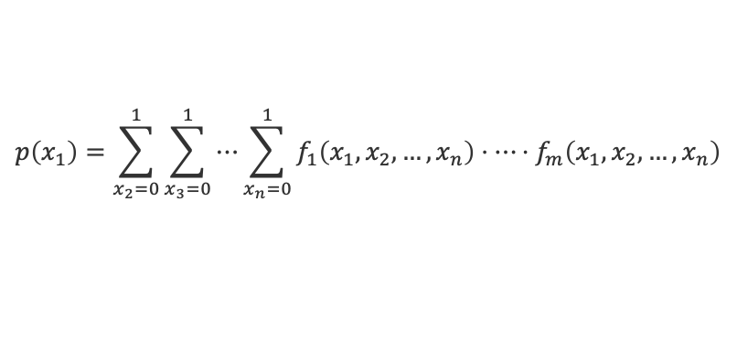
Marginalization using the Distributive Law
Observation 1: The marginal of a factor graph is a sum (over all values of all hidden variables) of a product (of factor functions).
Observation 2: Turning a sum of products with a common factor into a product of sums using the distributive law saves computation!
Observation 3: In a typical factor graph, functions only depend on a small number of variables.
$$p\left(x_{1}\right)=\sum_{x_{2}=0}^{1}{\sum_{x_{3}=0}^{1}{⋯\sum_{x_{n}=0}^{1}{f_{1}\left(x_{1},x_{2},…,x_{n}\right)⋅⋯⋅f_{m}\left(x_{1},x_{2},…,x_{n}\right)}}}$$
$$a⋅b+a⋅c=a⋅\left(b+c\right)$$
3 operations
2 operations

Slide 15





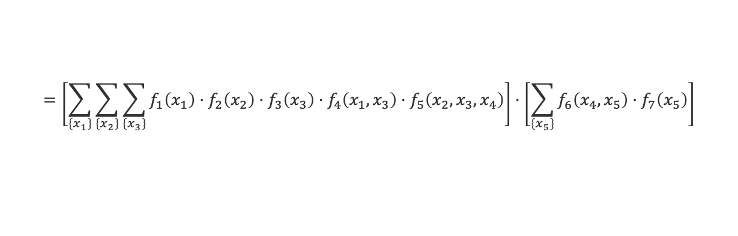





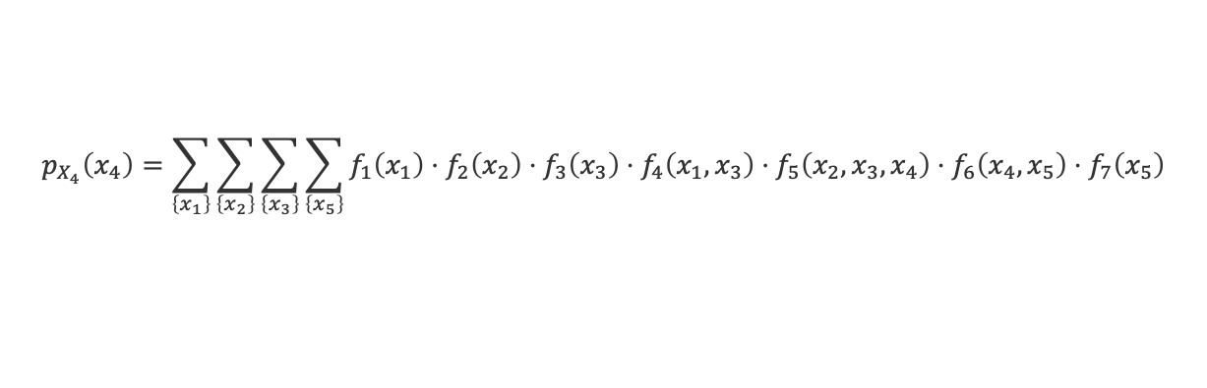







Sum-Product Algorithm: Non-normalized Marginals
$$f_{3}$$
$$f_{1}$$
$$f_{4}$$
$$X_{3}$$
$$X_{1}$$
$$f_{5}$$
$$f_{6}$$
$$f_{7}$$
$$X_{4}$$
$$X_{5}$$
$$f_{2}$$
$$m_{f_{5}→X_{4}}\left(x_{4}\right)$$
$$m_{f_{6}→X_{4}}\left(x_{4}\right)$$
$$X_{2}$$
Message $m_{f_{j}→X_{i}}\left(x_{i}\right)$ is the sum over all variables in the subtree rooted at $f_{j}$ with $X_{i}=x_{i}$
$$p_{X_{4}}\left(x_{4}\right)=\sum_{\left\{x_{1}\right\}}{\sum_{\left\{x_{2}\right\}}{\sum_{\left\{x_{3}\right\}}{\sum_{\left\{x_{5}\right\}}{f_{1}\left(x_{1}\right)⋅f_{2}\left(x_{2}\right)⋅f_{3}\left(x_{3}\right)⋅f_{4}\left(x_{1},x_{3}\right)⋅f_{5}\left(x_{2},x_{3},x_{4}\right)⋅f_{6}\left(x_{4},x_{5}\right)⋅f_{7}\left(x_{5}\right)}}}}$$
$$=\left[\sum_{\left\{x_{1}\right\}}{\sum_{\left\{x_{2}\right\}}{\sum_{\left\{x_{3}\right\}}{f_{1}\left(x_{1}\right)⋅f_{2}\left(x_{2}\right)⋅f_{3}\left(x_{3}\right)⋅f_{4}\left(x_{1},x_{3}\right)⋅f_{5}\left(x_{2},x_{3},x_{4}\right)}}}\right]⋅\left[\sum_{\left\{x_{5}\right\}}{f_{6}\left(x_{4},x_{5}\right)⋅f_{7}\left(x_{5}\right)}\right]$$
$$m_{f_{5}→X_{4}}\left(x_{4}\right)$$
$$m_{f_{6}→X_{4}}\left(x_{4}\right)$$
Non-normalized Marginals are the product of all incoming messages from neighbouring factors!

Slide 16

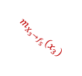
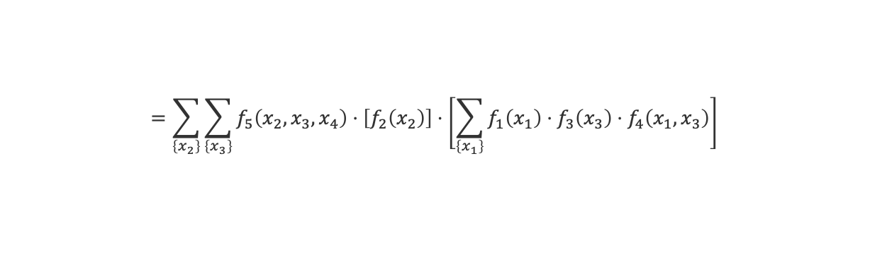

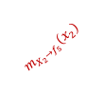






Sum-Product Algorithm: Message from Factor to Variable
$$f_{3}$$
$$f_{1}$$
$$f_{4}$$
$$X_{3}$$
$$m_{X_{3}→f_{5}}\left(x_{3}\right)$$
$$X_{1}$$
$$f_{5}$$
$$f_{6}$$
$$f_{7}$$
$$X_{4}$$
$$X_{5}$$
$$f_{2}$$
$$m_{f_{5}→X_{4}}\left(x_{4}\right)$$
$$m_{f_{6}→X_{4}}\left(x_{4}\right)$$
$$X_{2}$$
$$m_{X_{2}→f_{5}}\left(x_{2}\right)$$
Message $m_{X_{i}→f_{j}}\left(x_{i}\right)$ is the sum over all variables in the subtree rooted at $X_{i}$ with $X_{i}=x_{i}$
$$m_{f_{5}→X_{4}}\left(x_{4}\right)=\sum_{\left\{x_{1}\right\}}{\sum_{\left\{x_{2}\right\}}{\sum_{\left\{x_{3}\right\}}{f_{1}\left(x_{1}\right)⋅f_{2}\left(x_{2}\right)⋅f_{3}\left(x_{3}\right)⋅f_{4}\left(x_{1},x_{3}\right)⋅f_{5}\left(x_{2},x_{3},x_{4}\right)}}}$$
$$=\sum_{\left\{x_{2}\right\}}{\sum_{\left\{x_{3}\right\}}{f_{5}\left(x_{2},x_{3},x_{4}\right)⋅\left[f_{2}\left(x_{2}\right)\right]⋅\left[\sum_{\left\{x_{1}\right\}}{f_{1}\left(x_{1}\right)⋅f_{3}\left(x_{3}\right)⋅f_{4}\left(x_{1},x_{3}\right)}\right]}}$$
$$m_{X_{2}→f_{5}}\left(x_{2}\right)$$
$$m_{X_{3}→f_{5}}\left(x_{3}\right)$$
Messages from a factor to a variable sum out all neighboring variables weighted by their incoming message

Slide 17




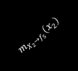






Sum-Product Algorithm: Message from Variable to Factor
$$f_{3}$$
$$m_{f_{3}→X_{3}}\left(x_{3}\right)$$
$$f_{1}$$
$$f_{4}$$
$$X_{3}$$
$$m_{X_{3}→f_{5}}\left(x_{3}\right)$$
$$X_{1}$$
$$f_{5}$$
$$f_{6}$$
$$f_{7}$$
$$m_{f_{4}→X_{3}}\left(x_{3}\right)$$
$$X_{4}$$
$$X_{5}$$
$$f_{2}$$
$$m_{f_{5}→X_{4}}\left(x_{4}\right)$$
$$m_{f_{6}→X_{4}}\left(x_{4}\right)$$
$$X_{2}$$
$$m_{X_{2}→f_{5}}\left(x_{2}\right)$$
$$m_{X_{3}→f_{5}}\left(x_{3}\right)=\sum_{\left\{x_{1}\right\}}{f_{1}\left(x_{1}\right)⋅f_{3}\left(x_{3}\right)⋅f_{4}\left(x_{1},x_{3}\right)}$$
$$=\left[f_{3}\left(x_{3}\right)\right]⋅\left[\sum_{\left\{x_{1}\right\}}{f_{1}\left(x_{1}\right)⋅f_{4}\left(x_{1},x_{3}\right)}\right]$$
$$m_{f_{3}→X_{3}}\left(x_{3}\right)$$
$$m_{f_{4}→X_{3}}\left(x_{3}\right)$$
Messages from a variable to a factor multiply incoming message from neighboring factors

Slide 18

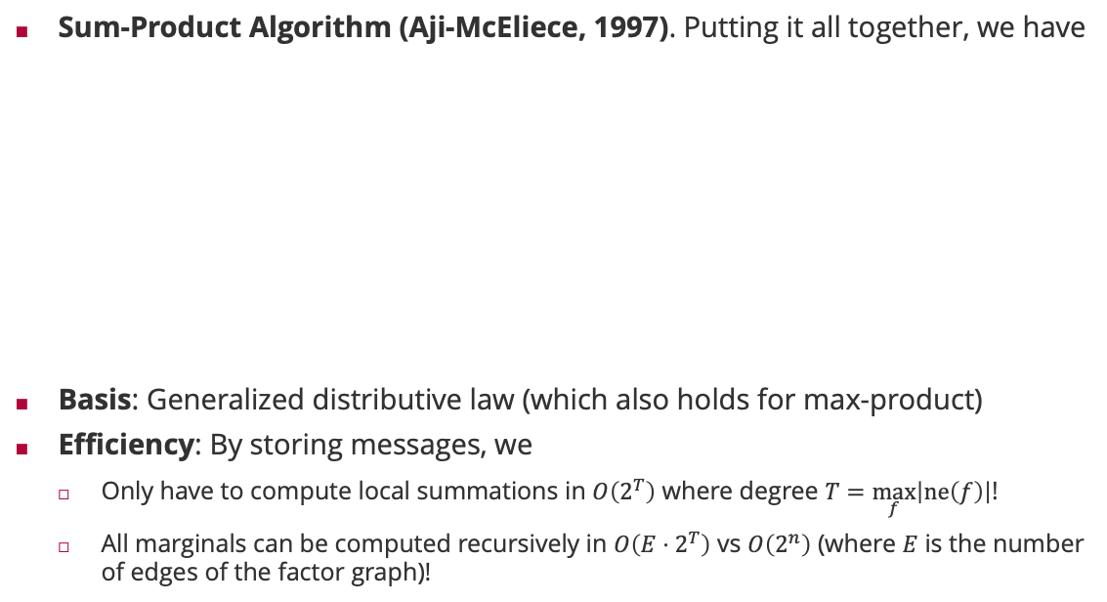
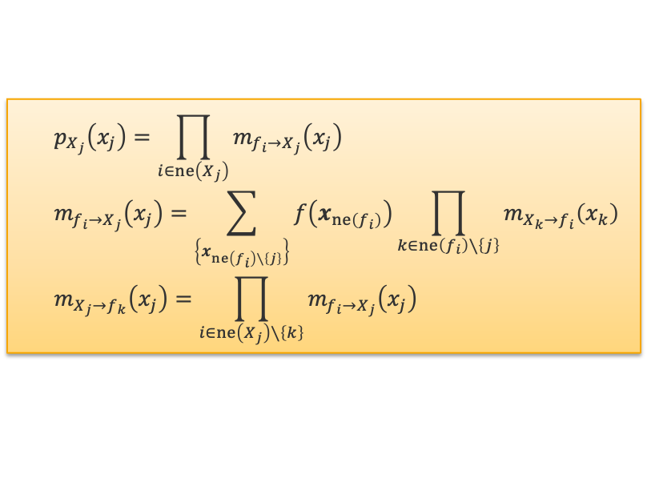
Sum-Product Algorithm
Sum-Product Algorithm (Aji-McEliece, 1997). Putting it all together, we have
Basis: Generalized distributive law (which also holds for max-product)
Efficiency: By storing messages, we
Only have to compute local summations in $O\left(2^{T}\right)$ where degree $T=\max_{f}\left|ne\left(f\right)\right|$!
All marginals can be computed recursively in $O\left(E⋅2^{T}\right)$ vs $O\left(2^{n}\right)$ (where $E$ is the number of edges of the factor graph)!
$$p_{X_{j}}\left(x_{j}\right)=\prod_{i∈ne\left(X_{j}\right)}{m_{f_{i}→X_{j}}\left(x_{j}\right)}$$
$$m_{f_{i}→X_{j}}\left(x_{j}\right)=\sum_{\left\{x_{ne\left(f_{i}\right)∖\left\{j\right\}}\right\}}{f\left(x_{ne\left(f_{i}\right)}\right)\prod_{k∈ne\left(f_{i}\right)∖\left\{j\right\}}{m_{X_{k}→f_{i}}\left(x_{k}\right)}}$$
$$m_{X_{j}→f_{k}}\left(x_{j}\right)=\prod_{i∈ne\left(X_{j}\right)∖\left\{k\right\}}{m_{f_{i}→X_{j}}\left(x_{j}\right)}$$
Robert McEliece (1942 – 2019)

Slide 19
Overview
Factor Graphs
Marginalization by Importance Sampling
Marginalization by the Sum-Product Algorithm
Practical Considerations in Message Passing

Slide 20

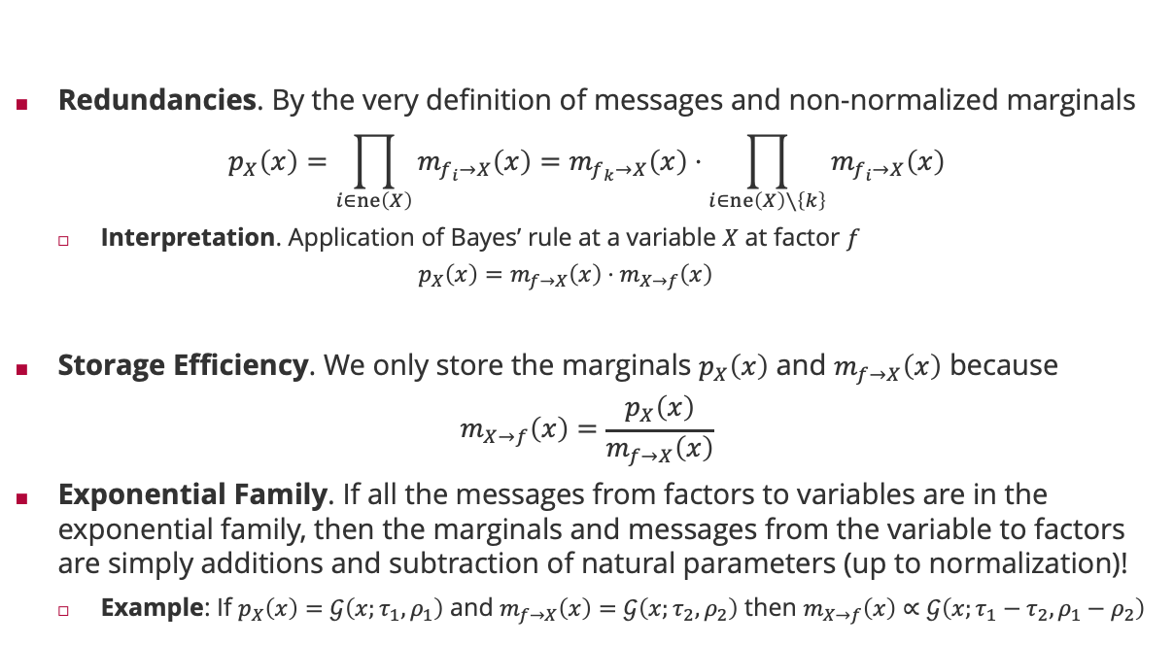
Even more efficiency
Redundancies. By the very definition of messages and non-normalized marginals
$$p_{X}\left(x\right)=\prod_{i∈ne\left(X\right)}{m_{f_{i}→X}\left(x\right)}=m_{f_{k}→X}\left(x\right)⋅\prod_{i∈ne\left(X\right)∖\left\{k\right\}}{m_{f_{i}→X}\left(x\right)}$$
Interpretation. Application of Bayes’ rule at a variable $X$ at factor $f$
$$p_{X}\left(x\right)=m_{f→X}\left(x\right)⋅m_{X→f}\left(x\right)$$
Storage Efficiency. We only store the marginals $p_{X}\left(x\right)$ and $m_{f→X}\left(x\right)$ because
$$m_{X→f}\left(x\right)=\frac{p_{X}\left(x\right)}{m_{f→X}\left(x\right)}$$
Exponential Family. If all the messages from factors to variables are in the exponential family, then the marginals and messages from the variable to factors are simply additions and subtraction of natural parameters (up to normalization)!
Example: If $p_{X}\left(x\right)=𝒢\left(x;τ_{1},ρ_{1}\right)$ and $m_{f→X}\left(x\right)=𝒢\left(x;τ_{2},ρ_{2}\right)$ then $m_{X→f}\left(x\right)∝𝒢\left(x;τ_{1}−τ_{2},ρ_{1}−ρ_{2}\right)$
$$m_{X→f_{k}}\left(x\right)$$
non-normalized posterior
Likelihood
non-normalized prior

Slide 21
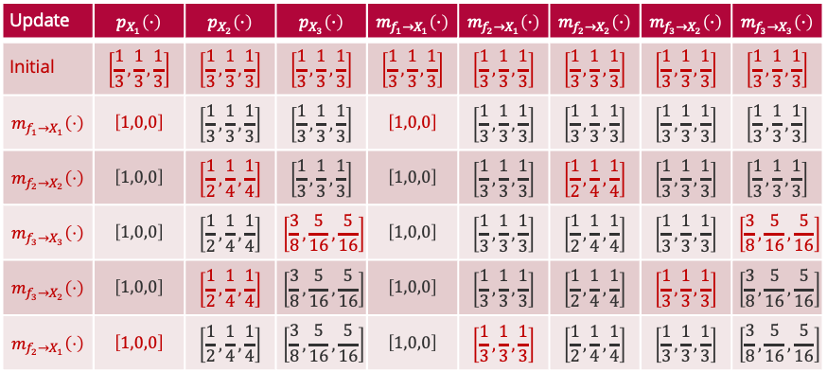
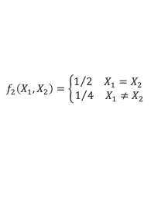

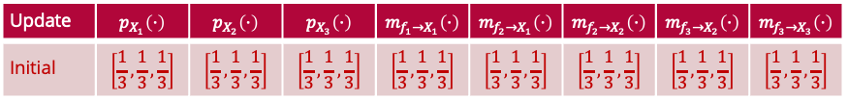
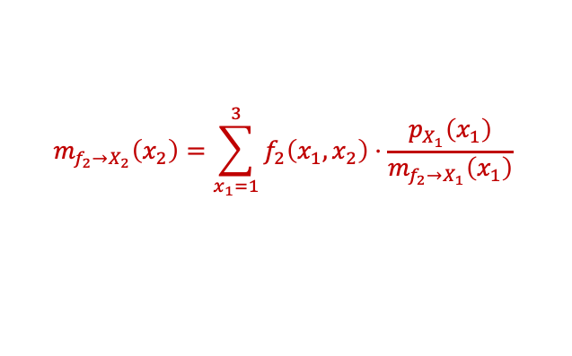
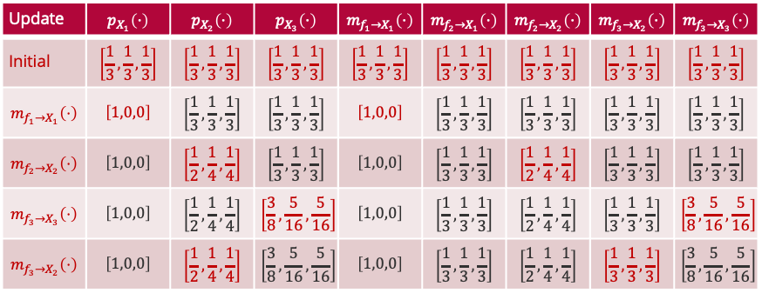


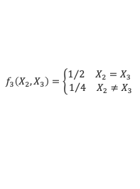

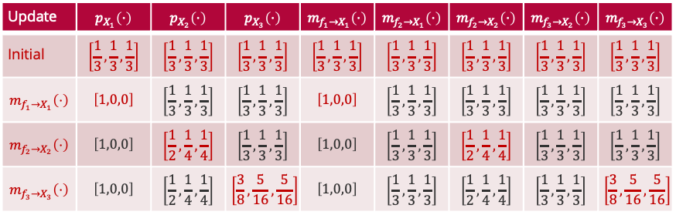

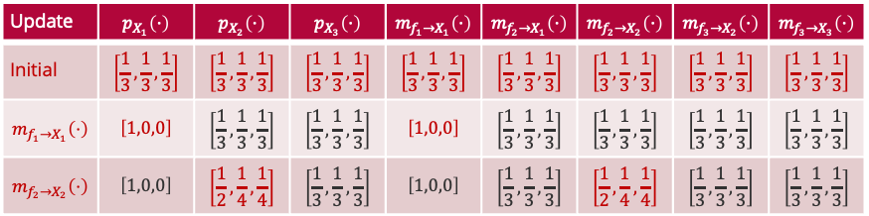



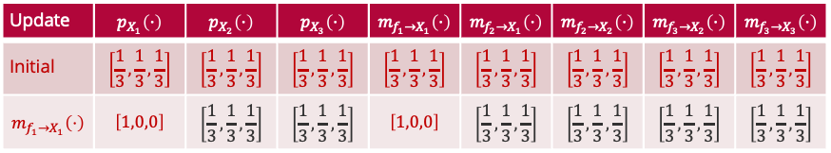
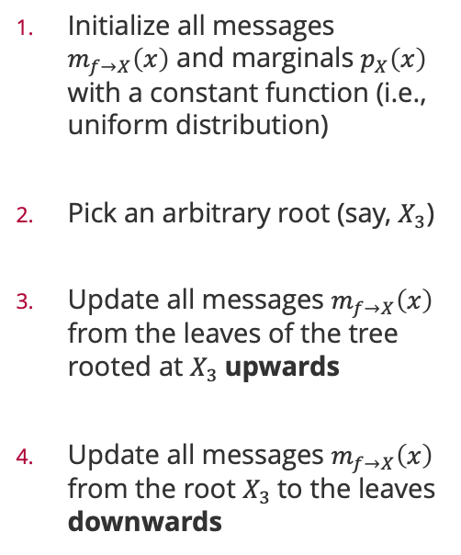


A Practical Implementation
Initialize all messages $m_{f→X}\left(x\right)$ and marginals $p_{X}\left(x\right)$ with a constant function (i.e., uniform distribution)
Pick an arbitrary root (say, $X_{3}$)
Update all messages $m_{f→X}\left(x\right)$ from the leaves of the tree rooted at $X_{3}$upwards
Update all messages $m_{f→X}\left(x\right)$ from the root $X_{3}$to the leaves downwards
$$f_{1}\left(X_{1}\right)=𝕀\left(X_{1}=1\right)$$
$$f_{2}\left(X_{1},X_{2}\right)=\left\{\begin{aligned}1/2 X_{1}=X_{2} \\ 1/4 X_{1}≠X_{2}\end{aligned}\right.$$
$$f_{3}\left(X_{2},X_{3}\right)=\left\{\begin{aligned}1/2 X_{2}=X_{3} \\ 1/4 X_{2}≠X_{3}\end{aligned}\right.$$
$$X_{1}$$
$$X_{2}$$
$$X_{3}$$
$$m_{f_{1}→X_{1}}\left(⋅\right)$$
$$m_{f_{2}→X_{1}}\left(⋅\right)$$
$$m_{f_{2}→X_{2}}\left(⋅\right)$$
$$m_{f_{3}→X_{2}}\left(⋅\right)$$
$$m_{f_{3}→X_{3}}\left(⋅\right)$$
Update | $$p_{X_{1}}\left(⋅\right)$$ | $$p_{X_{2}}\left(⋅\right)$$ | $$p_{X_{3}}\left(⋅\right)$$ | $$m_{f_{1}→X_{1}}\left(⋅\right)$$ | $$m_{f_{2}→X_{1}}\left(⋅\right)$$ | $$m_{f_{2}→X_{2}}\left(⋅\right)$$ | $$m_{f_{3}→X_{2}}\left(⋅\right)$$ | $$m_{f_{3}→X_{3}}\left(⋅\right)$$
Initial | $$\left[\frac{1}{3},\frac{1}{3},\frac{1}{3}\right]$$ | $$\left[\frac{1}{3},\frac{1}{3},\frac{1}{3}\right]$$ | $$\left[\frac{1}{3},\frac{1}{3},\frac{1}{3}\right]$$ | $$\left[\frac{1}{3},\frac{1}{3},\frac{1}{3}\right]$$ | $$\left[\frac{1}{3},\frac{1}{3},\frac{1}{3}\right]$$ | $$\left[\frac{1}{3},\frac{1}{3},\frac{1}{3}\right]$$ | $$\left[\frac{1}{3},\frac{1}{3},\frac{1}{3}\right]$$ | $$\left[\frac{1}{3},\frac{1}{3},\frac{1}{3}\right]$$
Update | $$p_{X_{1}}\left(⋅\right)$$ | $$p_{X_{2}}\left(⋅\right)$$ | $$p_{X_{3}}\left(⋅\right)$$ | $$m_{f_{1}→X_{1}}\left(⋅\right)$$ | $$m_{f_{2}→X_{1}}\left(⋅\right)$$ | $$m_{f_{2}→X_{2}}\left(⋅\right)$$ | $$m_{f_{3}→X_{2}}\left(⋅\right)$$ | $$m_{f_{3}→X_{3}}\left(⋅\right)$$
Initial | $$\left[\frac{1}{3},\frac{1}{3},\frac{1}{3}\right]$$ | $$\left[\frac{1}{3},\frac{1}{3},\frac{1}{3}\right]$$ | $$\left[\frac{1}{3},\frac{1}{3},\frac{1}{3}\right]$$ | $$\left[\frac{1}{3},\frac{1}{3},\frac{1}{3}\right]$$ | $$\left[\frac{1}{3},\frac{1}{3},\frac{1}{3}\right]$$ | $$\left[\frac{1}{3},\frac{1}{3},\frac{1}{3}\right]$$ | $$\left[\frac{1}{3},\frac{1}{3},\frac{1}{3}\right]$$ | $$\left[\frac{1}{3},\frac{1}{3},\frac{1}{3}\right]$$
$$m_{f_{1}→X_{1}}\left(⋅\right)$$ | $$\left[1,0,0\right]$$ | $$\left[\frac{1}{3},\frac{1}{3},\frac{1}{3}\right]$$ | $$\left[\frac{1}{3},\frac{1}{3},\frac{1}{3}\right]$$ | $$\left[1,0,0\right]$$ | $$\left[\frac{1}{3},\frac{1}{3},\frac{1}{3}\right]$$ | $$\left[\frac{1}{3},\frac{1}{3},\frac{1}{3}\right]$$ | $$\left[\frac{1}{3},\frac{1}{3},\frac{1}{3}\right]$$ | $$\left[\frac{1}{3},\frac{1}{3},\frac{1}{3}\right]$$
Update | $$p_{X_{1}}\left(⋅\right)$$ | $$p_{X_{2}}\left(⋅\right)$$ | $$p_{X_{3}}\left(⋅\right)$$ | $$m_{f_{1}→X_{1}}\left(⋅\right)$$ | $$m_{f_{2}→X_{1}}\left(⋅\right)$$ | $$m_{f_{2}→X_{2}}\left(⋅\right)$$ | $$m_{f_{3}→X_{2}}\left(⋅\right)$$ | $$m_{f_{3}→X_{3}}\left(⋅\right)$$
Initial | $$\left[\frac{1}{3},\frac{1}{3},\frac{1}{3}\right]$$ | $$\left[\frac{1}{3},\frac{1}{3},\frac{1}{3}\right]$$ | $$\left[\frac{1}{3},\frac{1}{3},\frac{1}{3}\right]$$ | $$\left[\frac{1}{3},\frac{1}{3},\frac{1}{3}\right]$$ | $$\left[\frac{1}{3},\frac{1}{3},\frac{1}{3}\right]$$ | $$\left[\frac{1}{3},\frac{1}{3},\frac{1}{3}\right]$$ | $$\left[\frac{1}{3},\frac{1}{3},\frac{1}{3}\right]$$ | $$\left[\frac{1}{3},\frac{1}{3},\frac{1}{3}\right]$$
$$m_{f_{1}→X_{1}}\left(⋅\right)$$ | $$\left[1,0,0\right]$$ | $$\left[\frac{1}{3},\frac{1}{3},\frac{1}{3}\right]$$ | $$\left[\frac{1}{3},\frac{1}{3},\frac{1}{3}\right]$$ | $$\left[1,0,0\right]$$ | $$\left[\frac{1}{3},\frac{1}{3},\frac{1}{3}\right]$$ | $$\left[\frac{1}{3},\frac{1}{3},\frac{1}{3}\right]$$ | $$\left[\frac{1}{3},\frac{1}{3},\frac{1}{3}\right]$$ | $$\left[\frac{1}{3},\frac{1}{3},\frac{1}{3}\right]$$
$$m_{f_{2}→X_{2}}\left(⋅\right)$$ | $$\left[1,0,0\right]$$ | $$\left[\frac{1}{2},\frac{1}{4},\frac{1}{4}\right]$$ | $$\left[\frac{1}{3},\frac{1}{3},\frac{1}{3}\right]$$ | $$\left[1,0,0\right]$$ | $$\left[\frac{1}{3},\frac{1}{3},\frac{1}{3}\right]$$ | $$\left[\frac{1}{2},\frac{1}{4},\frac{1}{4}\right]$$ | $$\left[\frac{1}{3},\frac{1}{3},\frac{1}{3}\right]$$ | $$\left[\frac{1}{3},\frac{1}{3},\frac{1}{3}\right]$$
Update | $$p_{X_{1}}\left(⋅\right)$$ | $$p_{X_{2}}\left(⋅\right)$$ | $$p_{X_{3}}\left(⋅\right)$$ | $$m_{f_{1}→X_{1}}\left(⋅\right)$$ | $$m_{f_{2}→X_{1}}\left(⋅\right)$$ | $$m_{f_{2}→X_{2}}\left(⋅\right)$$ | $$m_{f_{3}→X_{2}}\left(⋅\right)$$ | $$m_{f_{3}→X_{3}}\left(⋅\right)$$
Initial | $$\left[\frac{1}{3},\frac{1}{3},\frac{1}{3}\right]$$ | $$\left[\frac{1}{3},\frac{1}{3},\frac{1}{3}\right]$$ | $$\left[\frac{1}{3},\frac{1}{3},\frac{1}{3}\right]$$ | $$\left[\frac{1}{3},\frac{1}{3},\frac{1}{3}\right]$$ | $$\left[\frac{1}{3},\frac{1}{3},\frac{1}{3}\right]$$ | $$\left[\frac{1}{3},\frac{1}{3},\frac{1}{3}\right]$$ | $$\left[\frac{1}{3},\frac{1}{3},\frac{1}{3}\right]$$ | $$\left[\frac{1}{3},\frac{1}{3},\frac{1}{3}\right]$$
$$m_{f_{1}→X_{1}}\left(⋅\right)$$ | $$\left[1,0,0\right]$$ | $$\left[\frac{1}{3},\frac{1}{3},\frac{1}{3}\right]$$ | $$\left[\frac{1}{3},\frac{1}{3},\frac{1}{3}\right]$$ | $$\left[1,0,0\right]$$ | $$\left[\frac{1}{3},\frac{1}{3},\frac{1}{3}\right]$$ | $$\left[\frac{1}{3},\frac{1}{3},\frac{1}{3}\right]$$ | $$\left[\frac{1}{3},\frac{1}{3},\frac{1}{3}\right]$$ | $$\left[\frac{1}{3},\frac{1}{3},\frac{1}{3}\right]$$
$$m_{f_{2}→X_{2}}\left(⋅\right)$$ | $$\left[1,0,0\right]$$ | $$\left[\frac{1}{2},\frac{1}{4},\frac{1}{4}\right]$$ | $$\left[\frac{1}{3},\frac{1}{3},\frac{1}{3}\right]$$ | $$\left[1,0,0\right]$$ | $$\left[\frac{1}{3},\frac{1}{3},\frac{1}{3}\right]$$ | $$\left[\frac{1}{2},\frac{1}{4},\frac{1}{4}\right]$$ | $$\left[\frac{1}{3},\frac{1}{3},\frac{1}{3}\right]$$ | $$\left[\frac{1}{3},\frac{1}{3},\frac{1}{3}\right]$$
$$m_{f_{3}→X_{3}}\left(⋅\right)$$ | $$\left[1,0,0\right]$$ | $$\left[\frac{1}{2},\frac{1}{4},\frac{1}{4}\right]$$ | $$\left[\frac{3}{8},\frac{5}{16},\frac{5}{16}\right]$$ | $$\left[1,0,0\right]$$ | $$\left[\frac{1}{3},\frac{1}{3},\frac{1}{3}\right]$$ | $$\left[\frac{1}{2},\frac{1}{4},\frac{1}{4}\right]$$ | $$\left[\frac{1}{3},\frac{1}{3},\frac{1}{3}\right]$$ | $$\left[\frac{3}{8},\frac{5}{16},\frac{5}{16}\right]$$
Update | $$p_{X_{1}}\left(⋅\right)$$ | $$p_{X_{2}}\left(⋅\right)$$ | $$p_{X_{3}}\left(⋅\right)$$ | $$m_{f_{1}→X_{1}}\left(⋅\right)$$ | $$m_{f_{2}→X_{1}}\left(⋅\right)$$ | $$m_{f_{2}→X_{2}}\left(⋅\right)$$ | $$m_{f_{3}→X_{2}}\left(⋅\right)$$ | $$m_{f_{3}→X_{3}}\left(⋅\right)$$
Initial | $$\left[\frac{1}{3},\frac{1}{3},\frac{1}{3}\right]$$ | $$\left[\frac{1}{3},\frac{1}{3},\frac{1}{3}\right]$$ | $$\left[\frac{1}{3},\frac{1}{3},\frac{1}{3}\right]$$ | $$\left[\frac{1}{3},\frac{1}{3},\frac{1}{3}\right]$$ | $$\left[\frac{1}{3},\frac{1}{3},\frac{1}{3}\right]$$ | $$\left[\frac{1}{3},\frac{1}{3},\frac{1}{3}\right]$$ | $$\left[\frac{1}{3},\frac{1}{3},\frac{1}{3}\right]$$ | $$\left[\frac{1}{3},\frac{1}{3},\frac{1}{3}\right]$$
$$m_{f_{1}→X_{1}}\left(⋅\right)$$ | $$\left[1,0,0\right]$$ | $$\left[\frac{1}{3},\frac{1}{3},\frac{1}{3}\right]$$ | $$\left[\frac{1}{3},\frac{1}{3},\frac{1}{3}\right]$$ | $$\left[1,0,0\right]$$ | $$\left[\frac{1}{3},\frac{1}{3},\frac{1}{3}\right]$$ | $$\left[\frac{1}{3},\frac{1}{3},\frac{1}{3}\right]$$ | $$\left[\frac{1}{3},\frac{1}{3},\frac{1}{3}\right]$$ | $$\left[\frac{1}{3},\frac{1}{3},\frac{1}{3}\right]$$
$$m_{f_{2}→X_{2}}\left(⋅\right)$$ | $$\left[1,0,0\right]$$ | $$\left[\frac{1}{2},\frac{1}{4},\frac{1}{4}\right]$$ | $$\left[\frac{1}{3},\frac{1}{3},\frac{1}{3}\right]$$ | $$\left[1,0,0\right]$$ | $$\left[\frac{1}{3},\frac{1}{3},\frac{1}{3}\right]$$ | $$\left[\frac{1}{2},\frac{1}{4},\frac{1}{4}\right]$$ | $$\left[\frac{1}{3},\frac{1}{3},\frac{1}{3}\right]$$ | $$\left[\frac{1}{3},\frac{1}{3},\frac{1}{3}\right]$$
$$m_{f_{3}→X_{3}}\left(⋅\right)$$ | $$\left[1,0,0\right]$$ | $$\left[\frac{1}{2},\frac{1}{4},\frac{1}{4}\right]$$ | $$\left[\frac{3}{8},\frac{5}{16},\frac{5}{16}\right]$$ | $$\left[1,0,0\right]$$ | $$\left[\frac{1}{3},\frac{1}{3},\frac{1}{3}\right]$$ | $$\left[\frac{1}{2},\frac{1}{4},\frac{1}{4}\right]$$ | $$\left[\frac{1}{3},\frac{1}{3},\frac{1}{3}\right]$$ | $$\left[\frac{3}{8},\frac{5}{16},\frac{5}{16}\right]$$
$$m_{f_{3}→X_{2}}\left(⋅\right)$$ | $$\left[1,0,0\right]$$ | $$\left[\frac{1}{2},\frac{1}{4},\frac{1}{4}\right]$$ | $$\left[\frac{3}{8},\frac{5}{16},\frac{5}{16}\right]$$ | $$\left[1,0,0\right]$$ | $$\left[\frac{1}{3},\frac{1}{3},\frac{1}{3}\right]$$ | $$\left[\frac{1}{2},\frac{1}{4},\frac{1}{4}\right]$$ | $$\left[\frac{1}{3},\frac{1}{3},\frac{1}{3}\right]$$ | $$\left[\frac{3}{8},\frac{5}{16},\frac{5}{16}\right]$$
Update | $$p_{X_{1}}\left(⋅\right)$$ | $$p_{X_{2}}\left(⋅\right)$$ | $$p_{X_{3}}\left(⋅\right)$$ | $$m_{f_{1}→X_{1}}\left(⋅\right)$$ | $$m_{f_{2}→X_{1}}\left(⋅\right)$$ | $$m_{f_{2}→X_{2}}\left(⋅\right)$$ | $$m_{f_{3}→X_{2}}\left(⋅\right)$$ | $$m_{f_{3}→X_{3}}\left(⋅\right)$$
Initial | $$\left[\frac{1}{3},\frac{1}{3},\frac{1}{3}\right]$$ | $$\left[\frac{1}{3},\frac{1}{3},\frac{1}{3}\right]$$ | $$\left[\frac{1}{3},\frac{1}{3},\frac{1}{3}\right]$$ | $$\left[\frac{1}{3},\frac{1}{3},\frac{1}{3}\right]$$ | $$\left[\frac{1}{3},\frac{1}{3},\frac{1}{3}\right]$$ | $$\left[\frac{1}{3},\frac{1}{3},\frac{1}{3}\right]$$ | $$\left[\frac{1}{3},\frac{1}{3},\frac{1}{3}\right]$$ | $$\left[\frac{1}{3},\frac{1}{3},\frac{1}{3}\right]$$
$$m_{f_{1}→X_{1}}\left(⋅\right)$$ | $$\left[1,0,0\right]$$ | $$\left[\frac{1}{3},\frac{1}{3},\frac{1}{3}\right]$$ | $$\left[\frac{1}{3},\frac{1}{3},\frac{1}{3}\right]$$ | $$\left[1,0,0\right]$$ | $$\left[\frac{1}{3},\frac{1}{3},\frac{1}{3}\right]$$ | $$\left[\frac{1}{3},\frac{1}{3},\frac{1}{3}\right]$$ | $$\left[\frac{1}{3},\frac{1}{3},\frac{1}{3}\right]$$ | $$\left[\frac{1}{3},\frac{1}{3},\frac{1}{3}\right]$$
$$m_{f_{2}→X_{2}}\left(⋅\right)$$ | $$\left[1,0,0\right]$$ | $$\left[\frac{1}{2},\frac{1}{4},\frac{1}{4}\right]$$ | $$\left[\frac{1}{3},\frac{1}{3},\frac{1}{3}\right]$$ | $$\left[1,0,0\right]$$ | $$\left[\frac{1}{3},\frac{1}{3},\frac{1}{3}\right]$$ | $$\left[\frac{1}{2},\frac{1}{4},\frac{1}{4}\right]$$ | $$\left[\frac{1}{3},\frac{1}{3},\frac{1}{3}\right]$$ | $$\left[\frac{1}{3},\frac{1}{3},\frac{1}{3}\right]$$
$$m_{f_{3}→X_{3}}\left(⋅\right)$$ | $$\left[1,0,0\right]$$ | $$\left[\frac{1}{2},\frac{1}{4},\frac{1}{4}\right]$$ | $$\left[\frac{3}{8},\frac{5}{16},\frac{5}{16}\right]$$ | $$\left[1,0,0\right]$$ | $$\left[\frac{1}{3},\frac{1}{3},\frac{1}{3}\right]$$ | $$\left[\frac{1}{2},\frac{1}{4},\frac{1}{4}\right]$$ | $$\left[\frac{1}{3},\frac{1}{3},\frac{1}{3}\right]$$ | $$\left[\frac{3}{8},\frac{5}{16},\frac{5}{16}\right]$$
$$m_{f_{3}→X_{2}}\left(⋅\right)$$ | $$\left[1,0,0\right]$$ | $$\left[\frac{1}{2},\frac{1}{4},\frac{1}{4}\right]$$ | $$\left[\frac{3}{8},\frac{5}{16},\frac{5}{16}\right]$$ | $$\left[1,0,0\right]$$ | $$\left[\frac{1}{3},\frac{1}{3},\frac{1}{3}\right]$$ | $$\left[\frac{1}{2},\frac{1}{4},\frac{1}{4}\right]$$ | $$\left[\frac{1}{3},\frac{1}{3},\frac{1}{3}\right]$$ | $$\left[\frac{3}{8},\frac{5}{16},\frac{5}{16}\right]$$
$$m_{f_{2}→X_{1}}\left(⋅\right)$$ | $$\left[1,0,0\right]$$ | $$\left[\frac{1}{2},\frac{1}{4},\frac{1}{4}\right]$$ | $$\left[\frac{3}{8},\frac{5}{16},\frac{5}{16}\right]$$ | $$\left[1,0,0\right]$$ | $$\left[\frac{1}{3},\frac{1}{3},\frac{1}{3}\right]$$ | $$\left[\frac{1}{2},\frac{1}{4},\frac{1}{4}\right]$$ | $$\left[\frac{1}{3},\frac{1}{3},\frac{1}{3}\right]$$ | $$\left[\frac{3}{8},\frac{5}{16},\frac{5}{16}\right]$$
$$m_{f_{2}→X_{2}}\left(x_{2}\right)=\sum_{x_{1}=1}^{3}{f_{2}\left(x_{1},x_{2}\right)⋅\frac{p_{X_{1}}\left(x_{1}\right)}{m_{f_{2}→X_{1}}\left(x_{1}\right)}}$$
$$m_{X_{1}→f_{2}}\left(x_{1}\right)$$

Slide 22
Summary
Factor Graphs
Generalization of Bayesian networks specifically designed for fast and easy inference
Date back to coding algorithms
Marginalization by Importance Sampling
There exists an easy-to-implement sampling algorithm for the marginal distributions
Sampling efficiency depends on the “match” of the proposal distributions with the marginal distributions
Marginalization by the Sum-Product Algorithm
Application of generalized distributive law
Trades memory (“messages”) for computation (“sums”)
Reduces the computational complexity to exponential in the largest out-degree of a factor rather than exponential in the number of variables!
If messages can be computes efficiently, there is no faster, exact algorithm for marginalization!

Slide 23
See you next week!

